Slide 1
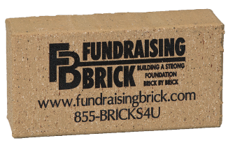
Laser Engraved
Bricks & Tiles
Fundraising Presentation
(855) BRICKS4U www.fundraisingbrick.com 105 Industrial Drive, Hermann, MO 65041

Slide 2
Make Your Campaign A Success
Select Fundraising Brick
Building A Strong Foundation Brick by Brick!
Thank you for requesting information from Fundraising Brick and our fundraising programs. We have enclosed detailed information on fundraising with engraved bricks and tiles and how our company can assure you meet your financial goals for your fundraising project. Fundraising with engraved bricks and tiles provides donors with a tangible and permanent link to your campaign and cause. These fundraisers have become increasingly popular and profitable over the years. We have seen donor bricks sell for prices from $50 to over $1,000 per engraved brick. Since your cost per brick will likely be under $20, you can see that there is huge potential for a large financial return.
Please review the enclosed materials in this presentation and also visit our website www.fundraisingbrick.com for additional information regarding our services. Once you have decided to partner with our team at Fundraising Brick on your fundraising project, contact us to get started on your campaign. Our friendly and professional customer service team is happy to answer any questions you may have. They can be reached Monday – Sunday from 7:00am to 9:00pm Central time at 1-855-BRICKS4U. We look forward to this opportunity.
Sincerely,
Jennifer Stemmley
Owner – Fundraising Brick
(855) BRICKS4U www.fundraisingbrick.com 105 Industrial Drive, Hermann, MO 65041

Slide 3
Fundraising Brick’s Products and Services:
American Made Quality Products Beautifully Marked With Our Laser Technology
Bricks
Quarry tiles
Glass tiles
Field tiles
A family run company with an A+ Better Business Bureau rating
A proven history of helping thousands of organizations nation wide to raise millions of dollars for their causes
Competitive Pricing
Price Match Guarantee
Free Services
Free Custom Samples (Select your shade, font, & inscription we will engrave a sample at no cost)
Free Standard Shipping for orders over $100.00
Free Clipart – over 1500 to select from
Free Design Assistance and Layout Examples
Free Donor Website Online Ordering Page to help you market your fundraiser – designed and hosted by Fundraising Brick
Free Marketing Tools – donor letters - order forms - brochure design – brick locator program
Free Virtual Engraved Brick Example Page – allow your donors to see what their brick will look like
Program Enhancers
Replica Full Size Bricks with Rubber Feet
Replica Miniature Bricks with Felt Pads
Replica Magnets
Donor Certificates
• No Contracts
• Shortest Order Lead Times In The Industry, Guaranteed
• Exceptional Customer Service
• Warranty
Lifetime Guarantee – backed by ASTM life testing at independent brick testing laboratory

Slide 4
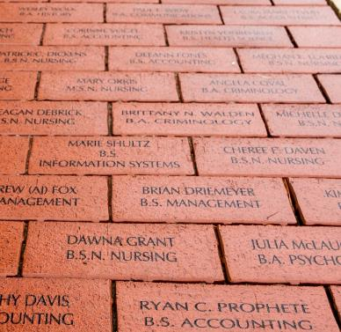
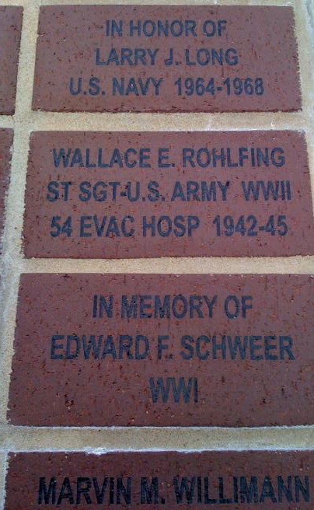
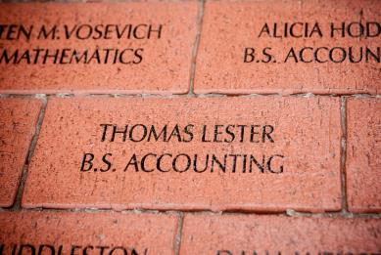
Laser Engraving Advantages
Laser Engraving VS. Sandblasting
Laser Engraved Bricks Installed in 2008 Laser Engraved Bricks Installed in 2005
(Photographed in 2013) (Photographed in 2013)

Slide 5
Laser Engraving Process
Laser Engraving
Our laser engraved bricks are more durable and are safer than sandblasted bricks. We permanently engrave bricks with our unique laser technology. What happens in the engraving process is called laser vitrification, or just vitrification for short. The laser directs an intensely hot beam onto the brick’s surface and changes the composition of the clay into a dark, glass-like mark that stands out on the engraved brick or etched tile. For our customers, this means endless possibilities because we can offer a wider variety of creative ideas by adding clipart, artwork, custom graphics, logos, signatures, depictions and fonts to your custom engraved brick or tile designs.
Laser Engraving Process
Laser engraving is a natural and permanent process. The laser beam interacts with the brick, changing the composition into ceramic by intense heat. The engraved laser mark on the brick is smooth, hard, and adhered permanently to the surrounding brick material. No paint, ink or epoxy fillers are added to achieve contrast. The brick laser marking process has been tested for durability for harsh weather conditions. Choosing laser engraving will guarantee a high-quality product far superior to any other engraving or etching processes on the market. Contact us today at 1-855-BRICKS4U to speak to a member of our team and get started on your project.
Laser Marking is Maintenance Free
Unlike sandblasting techniques, laser vitrification does not produce a cavity which attracts dirt, debris and invites erosion due to the inevitable freeze-thaw cycle in some harsh climates. The laser vitrification image is not affected by ultra-violet light, and is completely resistant to fading. Unlike other brick engraving processes, such as sandblasting, this low maintenance product requires minimal care. Simply wash away dirt and debris to expose a crisp, undamaged mark. The mark will never lose its clarity or quality.
Bricks Are "GREEN"
Laser Engraving is a natural and environmentally responsible option when revitalizing your community. No additives. All natural. Long lasting.

Slide 6
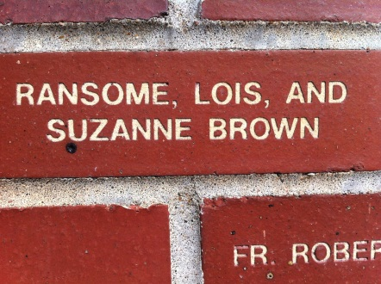
Newly Sandblasted Brick
Even a newly sandblasted brick has flaws (missing ink in the top leg of the “F”)

Slide 7
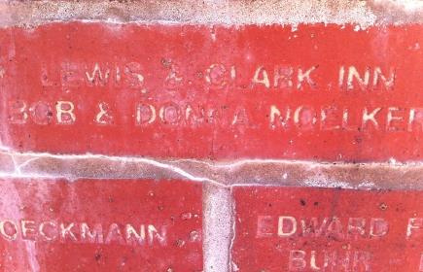
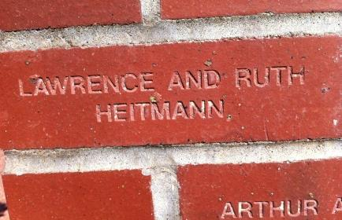
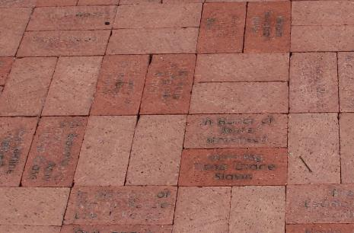
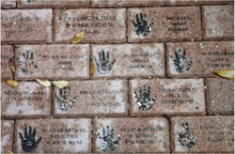
That once beautiful sandblasted brick will lose its epoxy or paint filler making the design and message unclear and difficult to read without the contrasting material. Dirt will get embedded in the now exposed crevices. Money will need to be spent for time and labor to clean out the dirty brick crevices. The exposed lettering and design can also become a hazard for heels from shoes and for those using assistive walking devices such as canes and walkers.
Sandblasted Bricks After One Year (Wall Installation – No foot traffic)
Sandblasted Bricks After One Year (Walkways with foot traffic)

Slide 8
Sandblasting Process
Sandblasting was first patented in the late 1900s and has had many uses over the decades in a variety of industries. Present day brick sandblasting is a multi-step process where a stencil is created first. Then the stencil is applied to the brick and placed in a chamber where an abrasive material is shot out of a high-powered machine to “blast out” the brick material. The removed brick material creates a deep crevice that is later filled with a contrasting epoxy or paint to make the mark stand out against the brick’s surface. The sandblasting method is more complex and much less durable.
When you first get your new sandblasted brick, it will be beautiful. Initially, the design and the lettering will be crisp and clean. The contrasting epoxy/paint-filled mark will stand out against the surface of the brick. However, the filler will begin to deteriorate after even a season’s worth of exposure to extreme heat or cold, the sun, rain or snow. If you have an indoor installation, exposure to the drying effects of a building’s heating and ventilation system will also degrade the filler material. Over time, these added materials weather and break down, leaving an unclear, deteriorated, and in some cases an unreadable mark.

Slide 9
We Want You To Decide For Yourself
Advantages | Fundraising Brick's Laser Engraving | Sandblasting | Pantographing
Permanent Mark | ●
Cost Effective | ● | ● | ●
Intricate Graphics | ●
Maintenance Free | ●
No Fading | ●
Lifetime Warranty | ●
Crisp & Fine Detail | ●
Paint, Epoxy, Grout Fill (Not Permanent) |  | ● | ●
No Fill - Permanent Mark | ●
Hardened Glass Adhered Permanently to the Brick Surface | ●
Engrave on Clay and Concrete Materials |  | ● | ●
Environmentally Safe Green Technology | ●

Slide 10
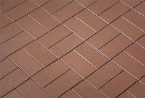
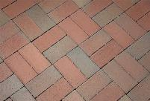
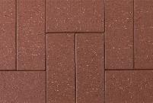
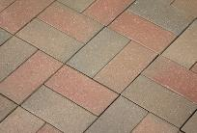
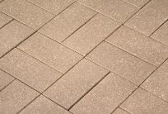
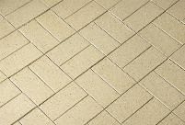
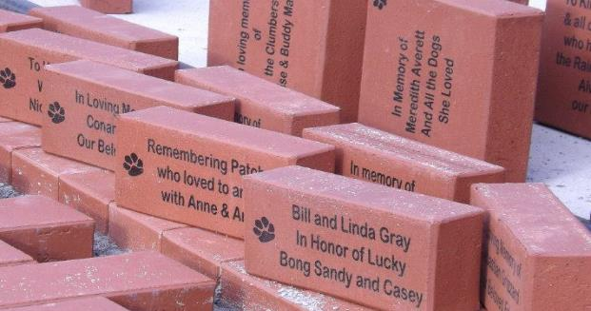
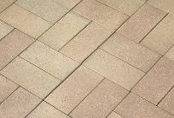
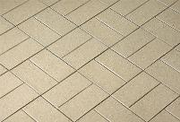
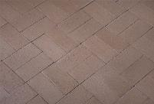
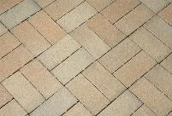
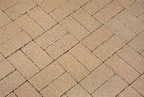
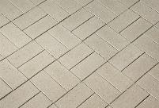
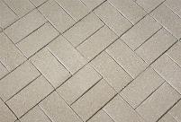
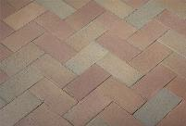
Brick Options
Regimental Red
Regimental Full Range
Admiral Red
Admiral Full Range
Chestnut Hill
Wheatfield
Most Popular Shade Regimental Red
Chestnut Full Range
Tumbleweed
Claret
Nutmeg Full Range
Nutmeg
Lighthouse Gray
Landmark Gray
Claret Full Range

Slide 11
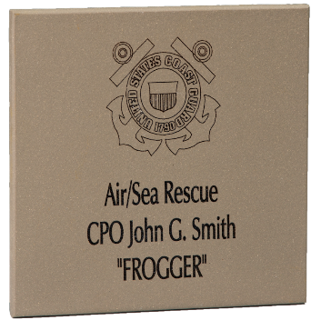
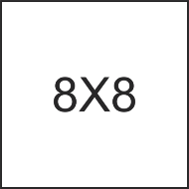
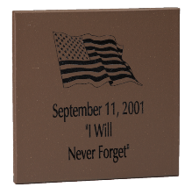
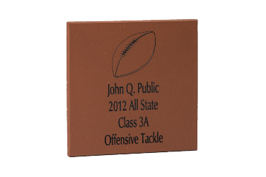
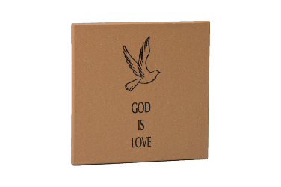
Quarry Tiles
Shades
Mayflower Red Auburn Adobe Oyster Bay Buckskin Plaza Gray Chestnut Brown
Quarry Tile Sizes - All Metropolitan tiles are ½” thick
Sizes

Slide 12
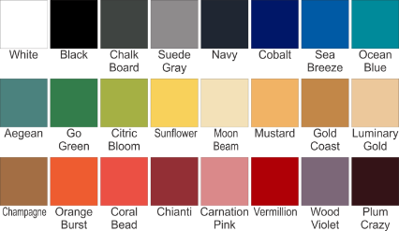
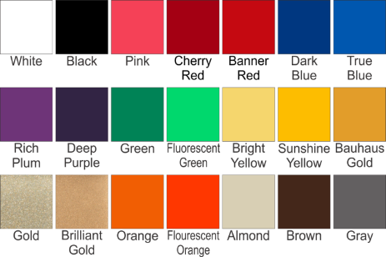
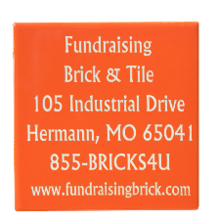
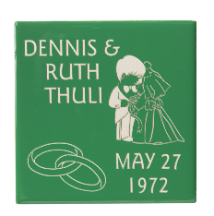
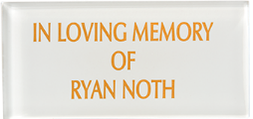
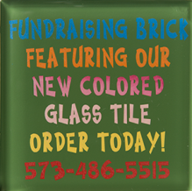
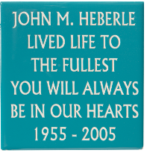
Glass & Field Tiles
Field Tile Shades
Glass Tile Shades
Glass Tile Paint Colors

Slide 13
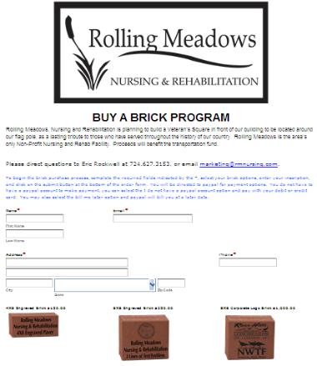
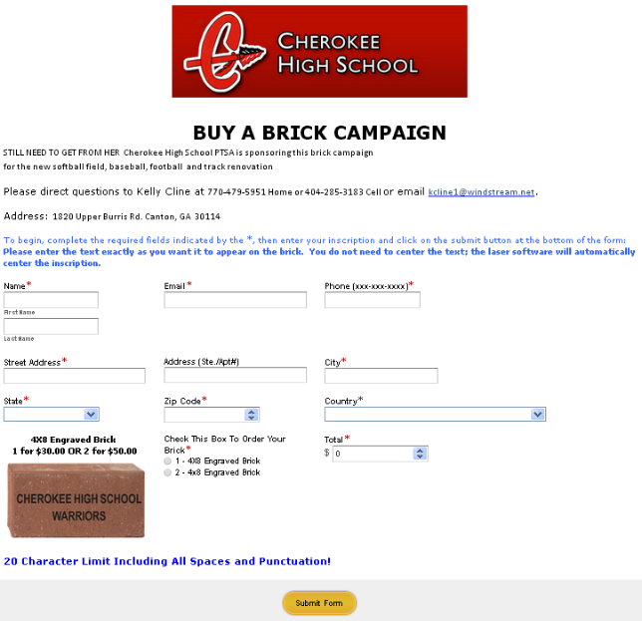
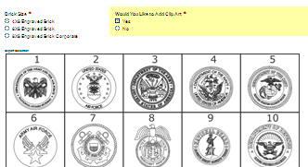
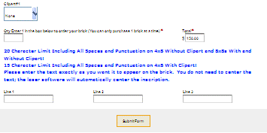
FREE Campaign Support & Donor Online Order Page
We will create a custom online ordering page for your group or organization. Your donors will have the ability to purchase their brick or tile online with ease. We will design and host the online ordering page. All that you are required to do for our online ordering system is setup a PayPal account for your organization. The PayPal account that you have setup is where the funds earned from online ordering will be transferred. You can then transfer the funds from PayPal to a bank account or directly withdraw the monies earned.

Slide 14
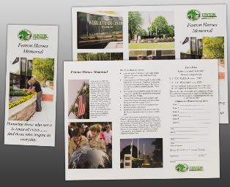
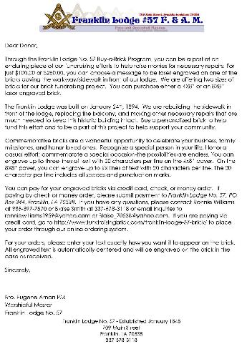
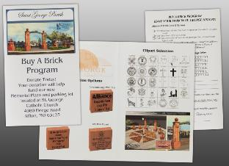
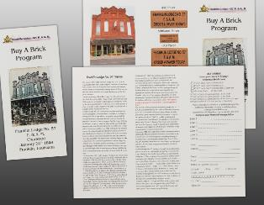
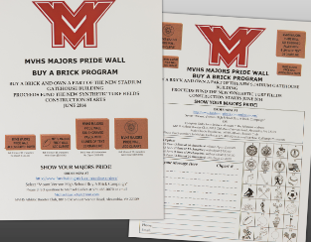
FREE Campaign Support
FREE Templates (Tri-Fold Flyer, Bi-Fold Flyer, Order Form, and Donor Letter)
At no additional charge, Fundraising Brick can customize a wide variety of advertising and marketing materials that will help you inform and promote your efforts. This includes: Pledge Sign-Up Forms, Brochures, Order Forms, Flyers, Mailers, Donor Letters. We have a large library of templates that we can customize for you by adding logos, pictures, fundraiser details, mission and vision statements. All of this is FREE when you order through Fundraising Brick, no hidden costs, no hidden fees!
Tri-Fold Examples
Donor Letter Example
Bi-Fold Example
One Page Example

Slide 15
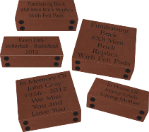
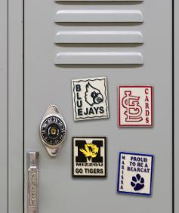
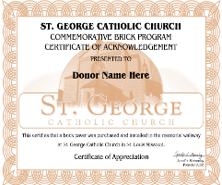
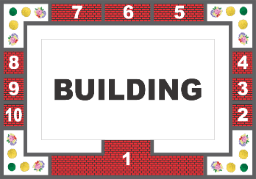
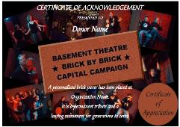
Program Enhancers
Fundraising Brick offers a variety of program enhancers. A program enhancer can assist in boosting your sales and earning additional funds for your project. Donors like to receive memorabilia to show that they have helped fund your special project. We offer Certificates of Authenticity, Mini Engraved Pavers, and Engraved Magnets that can all be used to enhance your fundraiser.
Mini Replica Bricks
2X2X1 & 3X3X1
The Miniature Brick Pavers and the
Magnets
Glass and Tile Magnets can be engraved with the donor’s inscription, your organization’s logo, a school mascot/logo, business information, clipart, and much more. A school, club, university, stadium, church, zoo, gift shop, store, can sell the magnet products. They can also be used as a business promotional item or a give away for a fundraiser or special project. The possibilities are endless. Proudly display the magnets for your family, friends, and co-workers to see on your refrigerator at home, a school locker, or a file cabinet at work. Available in three different sizes to fit your organizations needs.
engraved magnets make excellent program enhancers. They can be sold in addition to the 4X8 &
8X8 pavers and given as recognition to the donor. The miniature bricks and magnets can also be used as a standalone fundraiser.
Donor Certificates of Authenticity
Brick Locator Map
A certificate of authenticity can be mailed to your donors that purchased a brick paver for your organization. The Certificate of Authenticity establishes that a brick was purchased and installed with your organization. The certificate can be proudly displayed in an 8x10 frame for family and friends to see. Fundraising Brick will customize a certificate specifically for your project. We have a large variety of frame choices and color options. Contact us today for more information.
For some of our larger engraved brick installations in stadiums and outdoor memorials, we offer a Locator Map for donors so they can find their special engraved brick. Having a Locator Map is like having a treasure map and going on a treasure hunt. It is so much fun to find your brick with your special message engraved on it! Ask today about the possibility of a Locator Map for your project.
We will mark it and then map it. You will be provided with a
section number and a row and column number
for all of your donors. We will provide the list of names with the location to your installer. It is as easy as it sounds.

Slide 16
Full Size Replica Pavers With Rubber Feet
For the same cost as bricks for installation, our Replica Bricks come with rubber feet on the bottom so that the donor can safely display them on a shelf, desk, table, or floor.
Not only will your supporters/donors be able to own a little piece of the project, it is a great way to increase sales for your fundraiser.
We suggest that Replica Bricks be priced at approximately half the price of your installation bricks. For example, if you are selling a 4X8 paver for $100.00, then the replica should be offered to the donor for $50.00. If you are selling the 8X8 paver for $250.00, then the replica should be offered to the donor for $125.00.
Replica Bricks and Tiles cost you the same as regular donor bricks/tiles and count towards volume discounts. Shipping is included in the price if the replicas are shipped to the fundraiser with the rest of your order and distributed by your organization.
Replica bricks and tiles shipped directly to the donor will be charged $10.00 extra for shipping and handling and will be packed in an attractive single brick/tile shipping box.

Slide 17
Online Virtual Brick Designer
Fundraising Brick has a virtual brick designer on our website. This allows your donors to view what their engraved brick will look like. They will be able to select the brick shade, size, font, and clipart. We are excited to introduce this new online feature and hope that your donors will utilize this tool to visualize their laser engraved brick.
IN HONOR OF
KYLE LEWIS
1974 - 2005
Paver Brick Quarry Tile
Text Only Clipart With Text Logo Only
Size: 4X8 8X8
Shade:
Font:
Clipart:
Line 1
Line 2
Line 3
Wheatfield
Arial
Select Clipart Example
IN HONOR OF
KYLE LEWIS
1974 - 2005
CLICK HERE TO VIEW YOUR PAVER OR TILE

Slide 18
Our Other Services
1. No Contracts - Unlike most of our competition, Fundraising Brick does NOT require contracts and there are no hidden fees with our services. We are certain that your organization will choose Fundraising Brick as their engraved brick provider and do not rely on tying you down with a contract. We are upfront and honest about all costs involved in your fundraising project. We want your organization to have a successful brick or tile campaign and can help you every step of the way.
2. Warranty - Fundraising Brick warrants, through its Limited Lifetime Warranty, that its brick laser engraving processes will be of good quality and workmanship and will not fade, chip, oxidize, peel or separate from the brick, paver or tile for the life of the surface of the engraved brick, paver or tile. Fundraising Brick requires that the brick, paver or tile manufacturer meet all ASTM (American Standards of Testing Materials) standards for quality, durability and longevity. This warranty is limited to the repair or replacement of any laser engraving process onto a brick, paver or tile meeting ASTM standards. Any laser engraving process that prove(s) defective will be repaired or replaced by Fundraising Brick provided that such defect is due to faulty material or workmanship on the part of Fundraising Brick and not the result of tampering, vandalism, misuse, abuse, improper installation or maintenance misapplication, natural disaster or acts of God, excluding normal environmental conditions such as rain, sleet, snow and freeze/thaw conditions.
3. Price Match - We are committed to providing the lowest prices in the industry! We want our customers to receive the best pricing and quality available from any brick engraving company. If you find a competitor with a lower price, we will MATCH IT and still include all of our other FREE services. All you have to do is provide us with a written quote from our competition and if their price is lower than ours, we will MATCH IT, GUARANTEED. We are confident that our pricing is extremely competitive and we are dedicated to helping organizations like yours earn as much funding as possible for your brick or tile fundraising project.

Slide 19
Our Other Services
4. 24/7 Service - Our fundraising team is available to you at any time for guidance and support. We realize that most fundraising project leaders are volunteering for their organization and have a limited amount of time to spend on these projects during regular business hours. This is why our highly experienced team is available 24/7, yes including evenings and weekends to assist you with your special fundraising project. This sets us aside from our competition and is a service that only Fundraising Brick offers to our clients. Call us anytime at 855-BRICKS4U - because we know things happen and questions come up at the oddest times. Our team is at your service!
5. On Time Delivery - As part of our commitment to service and quality,
we honor our promise to you of coming through with
your order and within the timeframe agreed upon.
If necessary, our dedicated team will work around
the clock to meet your deadline. Regardless of your location in the contiguous United States, we guarantee that we get you your order faster than any of our competitors. We know that, with your order, you have many people counting on you to come through with their engraved messages and dedications to loved ones. We want to be the company that helps you with making those messages and dedications come alive - and on time - every time.
6. Marketing Assistance - Our team of fundraising experts have decades of experience in promoting and bolstering support for brick fundraising campaigns in a variety of industries and businesses. We work hard to help you get the most donors we can and getting them as excited about the project as we are.
7. Fundraising Brick is the Industry Leader for laser engraved bricks and tiles – We are the pioneers in this industry and have been engraving bricks and tiles for more than 20 years. We have more knowledge and expertise in the laser brick engraving and fundraising than any of our competition.
8. Last but not least, because Fundraising Brick cares about you and your project and our experienced staff is dedicated to making you fundraiser a success.
100% SATISFACTION GUARANTEED ALL THE TIME, EVERYTIME!

Slide 20
Clipart & Fonts
Over 1500 Free Clipart - We can generate a custom clipart selection for your organization
Large Font Selection
Custom Fonts Available Upon Request

Slide 21
Brick Layout Options With Clipart
Recommendations for Bricks Engraved With Clipart
Clipart engraved 1” tall
Engrave 2 lines of text with clipart on either line 1, line 2, or line 3 - 20 characters per line
Engrave with 3 lines of text with clipart in the top left/right corner or to the left/right of the text - Limit 17 characters per line
Clipart engraved 2” tall
All Military Emblems/Seals must be engraved 2” due to the detail in the graphic - Engrave with 3 lines of text clipart to the left or
right of text - Limit 15 characters per line
Clipart engraved 1” tall (8X8)
Engrave with 6 lines of text with clipart above or below the text - Limit 20 characters per line
Clipart engraved 2.75” tall (8X8)
All Military Emblems/Seals must be engraved 2” due to the detail in the graphic. It is recommended that if you offer military
graphics along with other clipart images that you engrave all of the clipart 2” tall for uniformity. Engrave with 4 lines of text with
clipart above or below the text - Limit 20 characters per line (We recommend only 4 lines of text max with Military Emblems)
If you do not see the clipart that you want from our library of over 1500, contact us and we can generate a custom clipart at no additional charge. NOTE: Limit 1 FREE clipart per brick

Slide 22
Layout Designs
If you’re like many of the groups we’ve worked with, you know the size of the space where you want to put the installation or memorial. You have strong feelings about the message you want your installation to convey, and you probably have seen other brick installations or memorials that have inspired you. Now, you’re asking, “What can we do with our brick installation?” No need to look any further. Our design team will work with you to customize a brick installation design that will encompass your vision and your organization’s message – to fit within the spacing you provide us. We have designed laser engraved brick installations for sidewalks, gardens, walls and other structures, both indoors and outdoors. Our staff can assist you with the design and layout for your brick fundraising project installation. We can calculate the space required and amount of bricks needed for your project.
Brick Patterns
Brick Layouts
Glass Tile

Slide 23
Financial Return
Projected Revenue & Cost - Engraved Brick Profit Projection
Size | Quantity Sold | Selling Price | Profit | Unit Cost | Total Engraving Cost | Projected Profit
4X8 | 100 | $100.00 | $10,000.00 | $18.00 | $1,800.00 | $8,200.00
4X8 | 250 | $100.00 | $25,000.00 | $18.00 | $4,500.00 | $20,500.00
4X8 | 500 | $100.00 | $50,000.00 | $18.00 | $9,000.00 | $41,000.00
4X8 | 750 | $100.00 | $75,000.00 | $18.00 | $13,500.00 | $61,500.00
4X8 | 1000 | $100.00 | $100,000.00 | $18.00 | $18,000.00 | $82,000.00
Size | Quantity Sold | Selling Price | Profit | Unit Cost | Total Engraving Cost | Projected Profit
4X8 | 100 | $150.00 | $15,000.00 | $18.00 | $1,800.00 | $13,200.00
4X8 | 250 | $150.00 | $37,500.00 | $18.00 | $4,500.00 | $33,000.00
4X8 | 500 | $150.00 | $75,000.00 | $18.00 | $9,000.00 | $66,000.00
4X8 | 750 | $150.00 | $112,500.00 | $18.00 | $13,500.00 | $99,000.00
4X8 | 1000 | $150.00 | $150,000.00 | $18.00 | $18,000.00 | $132,000.00
Size | Quantity Sold | Selling Price | Profit | Unit Cost | Total Engraving Cost | Projected Profit
8X8 | 100 | $250.00 | $25,000.00 | $30.00 | $3,000.00 | $22,000.00
8X8 | 250 | $250.00 | $62,500.00 | $30.00 | $7,500.00 | $55,000.00
8X8 | 500 | $250.00 | $125,000.00 | $30.00 | $15,000.00 | $110,000.00
8X8 | 750 | $250.00 | $187,500.00 | $30.00 | $22,500.00 | $165,000.00
8X8 | 1000 | $250.00 | $250,000.00 | $30.00 | $30,000.00 | $220,000.00
Size | Quantity Sold | Selling Price | Profit | Unit Cost | Total Engraving Cost | Projected Profit
8X8 | 100 | $500.00 | $50,000.00 | $30.00 | $3,000.00 | $47,000.00
8X8 | 250 | $500.00 | $125,000.00 | $30.00 | $7,500.00 | $117,500.00
8X8 | 500 | $500.00 | $250,000.00 | $30.00 | $15,000.00 | $235,000.00
8X8 | 750 | $500.00 | $375,000.00 | $30.00 | $22,500.00 | $352,500.00
8X8 | 1000 | $500.00 | $500,000.00 | $30.00 | $30,000.00 | $470,000.00

Slide 24
Brick Pricing
STANDARD PAVER, SIZE 4 X 8 X 2-1/4” OR HALF PAVER, SIZE 4 X 8 X 1-1/2”
ADDITIONAL DETAILS:
PAVER QUANTITY | LINES OF TEXT | UNIT COST
1 - 49 | 3 LINES OF TEXT / 20 CHARACTERS PER LINE | $21.00
50-99 | 3 LINES OF TEXT / 20 CHARACTERS PER LINE | $19.00
100-999 | 3 LINES OF TEXT / 20 CHARACTERS PER LINE | $18.00
OVER 1000 | 3 LINES OF TEXT / 20 CHARACTERS PER LINE | CONTACT FB FOR QUOTE
BRICK ORDERS MUST BE SUBMITTED IN THE WORD FORMAT PROVIDED BY FUNDRAISING BRICK ON CD OR VIA EMAIL
ORDERS SHALL BE ENGRAVED EXACTLY AS SUBMITTED IN UPPER CASE OR UPPER & LOWER CASE MIXED ALL BRICKS WILL BE ENGRAVED WITH A 15MM CHARACTER HEIGHT. CUSTOM SIZING IS AVAILABLE.
TYPICALLY ALL CUSTOM ENGRAVED LOGOS REQUIRE AN ADDITIONAL CHARGE OF $5.00 EACH, HOWEVER, DUE TO COMPLEXITY OF GRAPHICS, CUSTOM GRAPHICS AND LOGOS SHALL BE QUOTED SEPARATELY
4X8 and 8X8 Brick Arrays Require a custom quote
AVERAGE PRICE FOR CUSTOM GRAPHIC IS $75.00; HOWEVER, DUE TO COMPLEXITY OF GRAPHICS, CUSTOMER GRAPHICS AND LOGOS SHALL BE QUOTED SEPARATELY
GRAPHIC FILES ACCEPTED FOR LOGOS ARE: JPG, PDF, CDR, EPS, TIFF, DXF, DWG (CAMERA READY ARTWORK IS PREFERRED)
EXPEDITING IS AVAILABLE CONTACT FUNDRAISING BRICK
AN ENGRAVED 4X8 SAMPLE SHALL BE FURNISHED UPON REQUEST AT NO ADDITIONAL CHARGE
WE HAVE A $100 MINIMUM MERCHANDISE ORDER FEE WHICH WILL BE ENFORECED FOR ALL ORDERS. IN ADDITIION THERE WILL BE A $25.00 SHIPPING FEE FOR ALL ORDERS UNDER $250.00 IF YOU REQUIRE A LIFT GATE, THERE IS A $75.00 ADDITIONAL CHARGE PER DELIVERY. IF YOU REQUIRE AN APPOINTMENT FOR THE DELIVERY THERE IS A $40.00 ADDITIONAL CHARGE PER DELIVERY. ALL OTHER SHIPPING COSTS ARE INCLUDED IN THE PRICE OF THE BRICKS AND TILES FOR ALL ORDERS OVER $250.00. MERCHANDISE ORDERS UNDER $250.00 WILL BE SUBJECT TO A $25.00 SHIPPING CHARGE.
STANDARD PAVER, SIZE 8 X 8 X 2-1/4”
PAVER QUANTITY | LINES OF TEXT | UNIT COST
1 - 49 | 6 LINES OF TEXT / 20 CHARACTERS PER LINE | $36.00
50-99 | 6 LINES OF TEXT / 20 CHARACTERS PER LINE | $32.00
100-999 | 6 LINES OF TEXT / 20 CHARACTERS PER LINE | $30.00
OVER 1000 | 6 LINES OF TEXT / 20 CHARACTERS PER LINE | CONTACT FB FOR QUOTE
MINIATURE BRICKS (WITH FELT-BACKING) SIZE 2-3/4 X 1-1/2” X 1” 4X8 REPLICA’S
PAVER QUANTITY | LINES OF TEXT | UNIT COST
1 - 49 | 3 LINES OF TEXT / 20 CHARACTERS PER LINE | $11.00
50-99 | 3 LINES OF TEXT / 20 CHARACTERS PER LINE | $8.00
100-999 | 3 LINES OF TEXT / 20 CHARACTERS PER LINE | $6.00
OVER 1000 | 3 LINES OF TEXT / 20 CHARACTERS PER LINE | CONTACT FB FOR QUOTE
MINIATURE BRICKS (WITH FELT-BACKING) SIZE 3X3” X 1” 8X8 REPLICA’S
PAVER QUANTITY | LINES OF TEXT | UNIT COST
1 - 49 | 6 LINES OF TEXT / 20 CHARACTERS PER LINE | $12.00
50-99 | 6 LINES OF TEXT / 20 CHARACTERS PER LINE | $10.00
100-999 | 6 LINES OF TEXT / 20 CHARACTERS PER LINE | $8.00
OVER 1000 | 6 LINES OF TEXT / 20 CHARACTERS PER LINE | CONTACT FB FOR QUOTE
BLANK BRICK PAVERS
SIZE | BLANK | UNIT COST
4 X 8 HALF | BLANK | $3.00
4 X 8 FULL | BLANK | $5.00
8 X 8 FULL | BLANK | $9.00
SIZE 8X10 | DONOR RECOGNITION CERTIFICATE | $3.50 EACH

Slide 25
Tile Pricing (Quarry & Glass)
SIZE 4” X 8” X 7/16” QUARRY TILE
TILE QUANTITY | LINES OF TEXT | UNIT COST
1 - 49 | 6 LINES OF TEXT / 20 CHARACTERS PER LINE | $36.00
50-99 | 6 LINES OF TEXT / 20 CHARACTERS PER LINE | $32.00
100-999 | 6 LINES OF TEXT / 20 CHARACTERS PER LINE | $30.00
OVER 1000 | 6 LINES OF TEXT / 20 CHARACTERS PER LINE | CONTACT FB FOR QUOTE
SIZE 6” X 6” X 7/16” QUARRY TILE
TILE QUANTITY | LINES OF TEXT | UNIT COST
1 - 49 | 5 LINES OF TEXT / 15 CHARACTERS PER LINE | $25.00
50-99 | 5 LINES OF TEXT / 15 CHARACTERS PER LINE | $22.00
100-999 | 5 LINES OF TEXT / 15 CHARACTERS PER LINE | $20.00
OVER 1000 | 5 LINES OF TEXT / 15 CHARACTERS PER LINE | CONTACT FB FOR QUOTE
SIZE 8” X 8” X 7/16” QUARRY TILE – 20 CHARACTERS LINE
TILE QUANTITY | LINES OF TEXT | UNIT COST
1 - 49 | 3 LINES OF TEXT / 20 CHARACTERS PER LINE | $21.00
50-99 | 3 LINES OF TEXT / 20 CHARACTERS PER LINE | $19.00
100-999 | 3 LINES OF TEXT / 20 CHARACTERS PER LINE | $18.00
OVER 1000 | 3 LINES OF TEXT / 20 CHARACTERS PER LINE | CONTACT FB FOR QUOTE
SIZE 3” X 6” X 1/4” GLASS TILE
TILE QUANTITY | LINES OF TEXT | UNIT COST
1 - 49 | 3 LINES OF TEXT / 15 CHARACTERS PER LINE | $25.00
50-99 | 3 LINES OF TEXT / 15 CHARACTERS PER LINE | $22.50
100-999 | 3 LINES OF TEXT / 15 CHARACTERS PER LINE | $20.00
OVER 1000 | 3 LINES OF TEXT / 15 CHARACTERS PER LINE | CONTACT FB FOR QUOTE
SIZE 4” X 8” X 1/4” GLASS TILE
TILE QUANTITY | LINES OF TEXT | UNIT COST
1 - 49 | 3 LINES OF TEXT / 20 CHARACTERS PER LINE | $35.00
50-99 | 3 LINES OF TEXT / 20 CHARACTERS PER LINE | $32.50
100-999 | 3 LINES OF TEXT / 20 CHARACTERS PER LINE | $30.00
OVER 1000 | 3 LINES OF TEXT / 20 CHARACTERS PER LINE | CONTACT FB FOR QUOTE
SIZE 6” X 6” X 1/4” GLASS TILE
TILE QUANTITY | LINES OF TEXT | UNIT COST
1 - 49 | 6 LINES OF TEXT / 15 CHARACTERS PER LINE | $45.00
50-99 | 6 LINES OF TEXT / 15 CHARACTERS PER LINE | $42.50
100-999 | 6 LINES OF TEXT / 15 CHARACTERS PER LINE | $40.00
OVER 1000 | 6 LINES OF TEXT / 15 CHARACTERS PER LINE | CONTACT FB FOR QUOTE

Slide 26
Field Tile Pricing
SIZE 4” X 4” X 7/32” FIELD TILE
TILE QUANTITY | LINES OF TEXT | UNIT COST
1 - 49 | 4 LINES OF TEXT / 15 CHARACTERS PER LINE | $22.00
50-99 | 4 LINES OF TEXT / 15 CHARACTERS PER LINE | $20.00
100-999 | 4 LINES OF TEXT / 15 CHARACTERS PER LINE | $18.00
OVER 1000 | 4 LINES OF TEXT / 15 CHARACTERS PER LINE | CONTACT FB FOR QUOTE
SIZE 3” X 6” X 7/32” FIELD TILE
TILE QUANTITY | LINES OF TEXT | UNIT COST
1 - 49 | 3 LINES OF TEXT / 20 CHARACTERS PER LINE | $22.00
50-99 | 3 LINES OF TEXT / 20 CHARACTERS PER LINE | $20.00
100-999 | 3 LINES OF TEXT / 20 CHARACTERS PER LINE | $18.00
OVER 1000 | 3 LINES OF TEXT / 20 CHARACTERS PER LINE | CONTACT FB FOR QUOTE
SIZE 6” X 6” X 7/32” FIELD TILE
TILE QUANTITY | LINES OF TEXT | UNIT COST
1 - 49 | 6 LINES OF TEXT / 15 CHARACTERS PER LINE | $40.00
50-99 | 6 LINES OF TEXT / 15 CHARACTERS PER LINE | $38.00
100-999 | 6 LINES OF TEXT / 15 CHARACTERS PER LINE | $36.00
OVER 1000 | 6 LINES OF TEXT / 15 CHARACTERS PER LINE | CONTACT FB FOR QUOTE
SIZE 4” X 4” X 7/32” FIELD TILE PAINTED
TILE QUANTITY | LINES OF TEXT | UNIT COST
1 - 49 | 4 LINES OF TEXT / 15 CHARACTERS PER LINE | $32.00
50-99 | 4 LINES OF TEXT / 15 CHARACTERS PER LINE | $30.00
100-999 | 4 LINES OF TEXT / 15 CHARACTERS PER LINE | $28.00
OVER 1000 | 4 LINES OF TEXT / 15 CHARACTERS PER LINE | CONTACT FB FOR QUOTE
SIZE 3” X 6” X 7/32” FIELD TILE PAINTED
TILE QUANTITY | LINES OF TEXT | UNIT COST
1 - 49 | 3 LINES OF TEXT / 20 CHARACTERS PER LINE | $32.00
50-99 | 3 LINES OF TEXT / 20 CHARACTERS PER LINE | $30.00
100-999 | 3 LINES OF TEXT / 20 CHARACTERS PER LINE | $28.00
OVER 1000 | 3 LINES OF TEXT / 20 CHARACTERS PER LINE | CONTACT FB FOR QUOTE
SIZE 6” X 6” X 7/32” FIELD TILE PAINTED
TILE QUANTITY | LINES OF TEXT | UNIT COST
1 - 49 | 6 LINES OF TEXT / 15 CHARACTERS PER LINE | $50.00
50-99 | 6 LINES OF TEXT / 15 CHARACTERS PER LINE | $48.00
100-999 | 6 LINES OF TEXT / 15 CHARACTERS PER LINE | $46.00
OVER 1000 | 6 LINES OF TEXT / 15 CHARACTERS PER LINE | CONTACT FB FOR QUOTE

Slide 27
Customer Service - Testimonials
Customer Service – 100% Satisfaction Guaranteed
Once you have contacted Fundraising Brick, you will notice a level of customer service that one rarely experiences anymore. It is almost like you have become a part of a family. We offer a 100% satisfaction guarantee with our products and we will do everything in our power to make you a happy customer. We do not just meet our customers' expectations; we pride ourselves on exceeding them by leaps and bounds. Our commitment is to you, to working as a team and assisting on your fundraising project. If you need it, all you have to do is ask and we will do our very best to accommodate your needs. We make ourselves available to you 24 hours a day. Call us anytime at 855-BRICKS4U - because we know things happen and questions come up at the oddest times. Our team is at your service!
Testimonials
A Lifesaver
“You are a life saver. I am so thankful you live close enough, our guys could pick them up today. Thanks again for all of your help. I hope we don't have an emergency rush order again, but if something comes up, it is nice to know you have my back!"
Millie G. - LAF & Community Cares Administrator
Anxious to Get Bricks Installed
“I received the bricks yesterday and they all look great! I am anxious to get them installed in the current memorial at Piper High School. Thank you for your help and if I know anyone wanting to do a similar project, I will let them know about your business."
Jackie K. - Piper High School - Kansas City, KS
Professionalism & Prompt Service
“Fundraising Brick helped our company by producing 300+ custom laser etched bricks for a fraternity house in college Park, Maryland. Fundraising Brick represents professionalism and was very prompt in all matters. I highly recommended Fundraising Brick if you are doing a fundraiser of any kind or a special order.”
Nicholas Philliou - College Park, MD
Courteous & Friendly
"It was a true pleasure to work with your company. Everyone I spoke with or emailed was prompt, courteous, and friendly. I look forward to working with you again in the future."
Pat Hall, Greyhound Friends, Inc. - Hopkinton, MA
Customer Service
The bricks look great!
Jackie R. - Fenton Parks and Recreation
That's great, Jennifer! What fast service!
Brenda O. - Van-Far Alumni
Willing & Accommodating
“Thank you! Thank you! Thank you! I appreciate your willingness to accommodate our request and please know you have played a huge part in Commencement at Silver Lake College of the Holy Family - the entire Class of 2013 is grateful."
Amy E. - Silver Lake College of the Holy Family - Wisconsin
Above & Beyond
“Thanks again for everything that you've done. You have gone above and beyond since we first started doing business with you. The brick has arrived and looks great. Thanks again!!"
Christine Schwab, Development Assistant - Cardinal Ritter Senior Services
Timeliness & Great Care
“2012 was a pleasure in our 'Paving the Way' efforts due mostly to your timeliness and great care in working with us. Our thanks.”
Virginia Webb - Jewish Geriatric Services
Profitable Project
“Hi, Jennifer! We absolutely LOVED all the brick work you did for us. This was quite a project for us and it made us a lot of money to help with a new room in our backyard area. We give your name to people when they inquire about [the bricks] for their own fundraising events We have a beautiful Path of History...in front of our Museum in Kernville.”
Vicki Middleworth, Project Chairman - Kern River Valley Historical Society
Kind & Professional
“Thank you, Jennifer, you are so kind and professional. It is great doing business with you. Until next time. All the best."
Elaine T. - Public Relations - Sandwich Glass Museum
Quality
"The patrons who bought bricks love the quality especially those businesses that purchased logo bricks."
Lance Roberts, Chester High School - Chester, SC

Slide 28
Questions & Answers
Frequently Asked Questions:
If you are a new committee that has been charged with coordinating a fundraiser for your company, we assembled a list of popular questions that usually come up during planning meetings. We have provided suggestions of what we have experienced over the years but they are NOT the only answers possible. As mentioned before, these questions should stimulate discussion amongst the committee members to ensure you have the most successful fundraising campaign you can.
Who will be our Campaign Manager or Project Leader?
There should be only one contact working with the engraver.
How much money do we need to raise?
This will depend on how large your project is and how long it will continue.
What costs will be associated with this fundraiser?
You must think through all possible costs that will incur with this project, from start to finish. Those figures will be used to calculate how much to charge for the bricks.
Who will design our project and is it large enough to raise the funds we need?
Do you have access to an architect, a landscape designer or someone who knows CAD software? Would they be willing to donate their time?
How do I calculate how many laser engraved bricks and blanks that I need?
If you are using 4”x8” bricks, you will need approximately 4.25 bricks for one square-foot of space. You will need your length times width (L x W) to obtain total square footage.
Where do I purchase the blank bricks?
Your purchase of the blanks (used to fill in space and/or as part of the non-engraved design) will be made through Belden Brick in Ohio. We will provide you the Belden distributor’s name so you can purchase your blanks from them. Your purchase of the laser engraved bricks will be through us at Fundraising Brick.
Do we have sufficient space or ground that is available for the end product?
Depending on the type of project you will be doing, check with the appropriate people for all special permits that you might need.
Do we want to create an engraved brick walkway, a memorial garden or a wall?
From past experience, creating a walkway with our beautiful laser engraved bricks is more straightforward and more cost-effective than a wall. However, your team’s decision about the end-product will need to reflect what is possible and will make the most sense in the space that you have available.
What shade of bricks do we want to use?
There are so many shades available today! Mixing and alternating different shades of brick can result in a truly unique and gorgeous design. All of the different shades of brick engrave beautifully.
On what type of base will the laser engraved bricks be laid?
Many people start with a sand and gravel base for laying their bricks. At a later date, they may want to mortar them in for a more permanent structure.

Slide 29
Questions & Answers
Who will lay the bricks, both the engraved donor bricks and the blanks?
Do you have access to a bricklayer that might be willing to donate their time to lay the bricks?
What type of font do we want on the engraved bricks?
We can direct you to the type of font which suits your style.
What are the price points we offer to our donors?
Depending on the size of bricks you are planning to use, the 4”x8” with three (3) lines of text (20 characters per line) will cost your company $18.00-$21.00 each. The suggested donor price is in the $150-$250/brick range.
The 8”x8” with six (6) lines of text (20 characters per line) will cost you $30.00-$36.00 each. The suggested donor price is in the $250-$500 range.
If you decide to add graphics or logos, you can double the donor prices.
We offer a 16”x16” brick array where we split the graphics and engrave it on four (4) bricks to create one large area. Please contact Fundraising Brick for custom pricing and the suggested donor price range.
Who are our donors?
Your donors can be members of your organization, community businesses and/or church members, members of the community.
How do we sell the bricks?
You can sell your bricks by letting us create a customized donor order form that you can send out via an email distribution list. If you have an existing website, you can also sell your bricks online. Please request additional information about ways to reach your donors.
How much time do I give my donors to place their orders?
Typically, you should give donors about 2-3 months to place their orders.
Should we offer graphics and clipart?
If you offer graphics, you can increase your donations greatly. (Please refer to our price sheet for all costs involved.) You can have one clipart free per brick. We have over 14 pages of clipart available.
In order to prevent additional set-up fees, we recommend that all clipart be located in the same location of the brick.
How do I place my orders with the donor’s text?
Once you are ready to place your order, give us a call and we will email you the correct text documents in which you will type your donor’s text.
How long will it take to receive my laser engraved bricks once the order is placed?
Normally, it takes about (2-4) weeks to receive an order after our receipt of the completed order form and payment.
Will we offer another phase in 6 months for re-orders?
By offering at least two (2) phases of engraved brick ordering per year to your donors, you can greatly increase your bottom line.
How will we do our ground-breaking ceremony for donors to view their laser engraved bricks?
Issue a press release with the local newspaper and email invitations.

Slide 30
Questions & Answers
Is the text upper and/or lower case?
This is the decision of the fundraising committee. You can have the text all upper case, or all lower case, or a combination.
What do the engraved bricks look like?
The laser mark has the appearance of a black glass finish. No paint or epoxy, but a permanent laser engraved mark.
What do you mean by a permanent laser mark? Why is the mark permanent?
The process is called Laser Vitrification, and the laser mark has been subjected to the harshest of environments, through independent studies conducted by Industrial Testing Laboratories, Inc.
What is the height of the character?
The individual character height for an upper case letter is 15 millimeters. The individual character height for a lower case letter is 11 millimeters. Fundraising Brick also provides our customers with custom size lettering. If you would like to have the letters engraved with a 12millimeter or 20millimeter character height, just ask. We can accommodate all of your specific needs.
Is my donation a tax deduction?
Verify with your accountant.
Is punctuation an additional space?
Yes, as well as the spaces in between words.
Which punctuation marks can be scribed?
Commas, quotation marks, ampersands, parenthesis, dash, periods, etc. Fundraising Brick can also engrave special characters for example, the Greek Alphabet, if required for your fundraiser.
Will I receive a certificate of recognition, or can one be sent to the person I am making the donation for?
Yes, to receive a certificate just let your sales representative know or specify on the order form the name that you would like to have printed on the certificate.
What if there is a spelling error in the donor name?
It is the responsibility of the donor to spell the name correctly, and the fundraising group's responsibility to enter the names correctly onto the text file documents. In an effort to reduce errors, Fundraising Brick recommends that you have one individual enter the names and a second individual spell check the document prior to submitting your order with Fundraising Brick.
If you have any other questions or just want to discuss your fundraiser, do not hesitate to contact us at:
Fundraising Brick - 105 Industrial Drive - Hermann, Missouri 65041
Jennifer Stemmley - CEO (email) jenny@fundraisingbrick.com (cell) 573-694-1127
Melissa Heldt - Sales Manager (email) missy@fundraisingbrick.com (cell) 573-694-4009
Toll Free - 855-BRICKS4U (855-274-2574) (p) 573-486-5515 (f) 636-600-5352

Slide 31
The Next Steps - See our fundraising guide and packet for additional details
1. Fundraiser Project Timeline/Organization
Complete the timeline which depicts milestones for when tasks, goals, and sales forecasts are reached. Complete daily, weekly, monthly sales projections based on predetermined goals. Decide how much money that your fundraiser would like to raise. Set the price of each brick to donors. Combine the price you pay for donor bricks and add the amount you would like to raise. This will determine your final sale price for the bricks or tiles. To help volunteers understand exactly what you need from them, inform them of your tasks, goals, and sales forecasts. Make all pertinent information visibly available to all volunteers. Set realistic goals…do not underestimate your abilities as a fundraiser. Assign the following roles to the individuals in charge of the fundraising project. In some cases, this is one person. Project Manager - Project Coordinator - Sales Manager
2. Define your Project
Is your project a walkway, wall, or patio? How many square feet will your project cover? A rule of thumb to consider is that it takes 9, 4x8” bricks to fill 2 square feet. How much money do you need to raise? What is your time line? If your project is a walkway or other paver-based installation, will you install on a sand base or on concrete? Installing on a sand base will allow you to complete your installation with a mix of engraved and blank bricks – the blank bricks can be easily replaced with donor bricks in the future.
3. Choose Your Brick or Tile
Select your brick or tile and font choice from our available selection.
4. Campaign Details
How much will you charge for each brick or tile? This will be determined by the size of your project, the amount of money you need to raise, the desirability of your cause, the demographics of your potential donor base, and other factors. We have seen 4x8” donor bricks being sold for as little as $50 each and as much as $1,000 each. Installation will be a major expense. We recommend that you get multiple quotes before committing to a contractor. Ask if they will donate their services in return for an engraved brick(s) to be installed with their company logo for free advertising. If they are not willing to donate their services, ask if they will offer a discounted rate in return for an engraved brick(s). Utilize our program enhancers to increase your donations.
5. Donor List and Strategy
Develop a strategy for advertising and marketing. One suggestion is to create a hierarchy for donation amounts, such as Silver, Gold and Platinum. Depending on the price of your donor bricks, designate dollar amount requirements for placing donors into the categories. For example, a minimum donation of $500 is required to be a Silver Donor, $1000 for Gold, and $5,000 for Platinum. When an individual or organization donates $500, offer a complimentary brick with their name and title of Silver Donor, as a reward. This and other strategies can be used to promote special rewards for large donations. Display flyers and other information about your Fundraiser at: Banks, Beauty Salons, Car Dealers, Restaurants, Fast Food Chains, Churches, Grocery Stores, Downtown Businesses, Health and Sports Clubs, Corporations (lunch/reception areas), Service Clubs, Funeral Chapels, Libraries, Schools, Colleges, Universities, Utility Companies, Retail Stores, Bulletin Boards. The direct mail promotional piece will work. Mail a letter to your list of potential donors. Use our donor letter template as a guide.
6. Call Fundraising Brick at 855-BRICKS4U or 573-486-5515

Slide 32
Toll Free: (855) BRICKS4U
Phone: 573-486-5515
Fax: 636-600-5352
www.fundraisingbrick.com
105 Industrial Drive
Hermann, MO 65041

